Slide 1
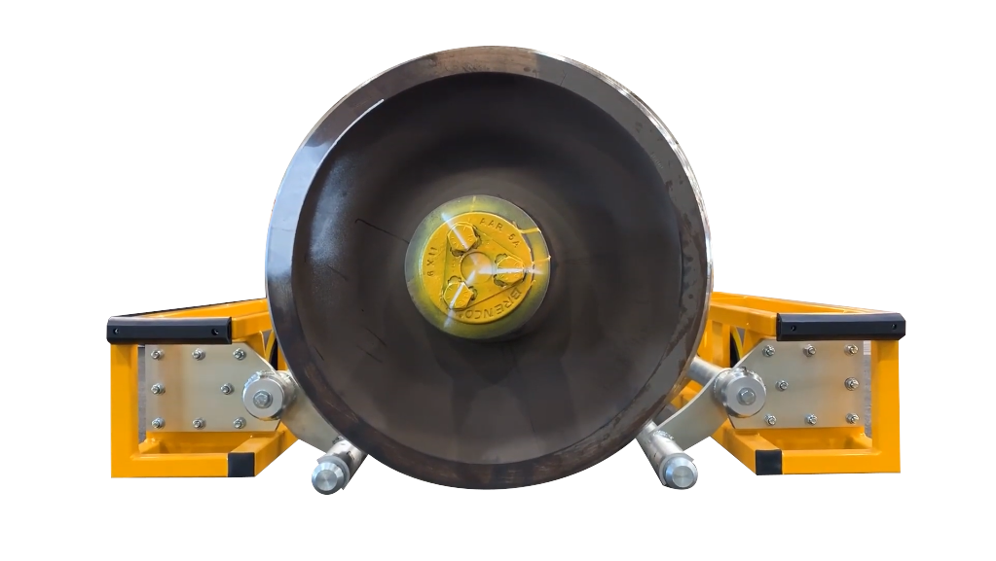

Wheelset Mover
by
custom-engineered solution

Slide 2
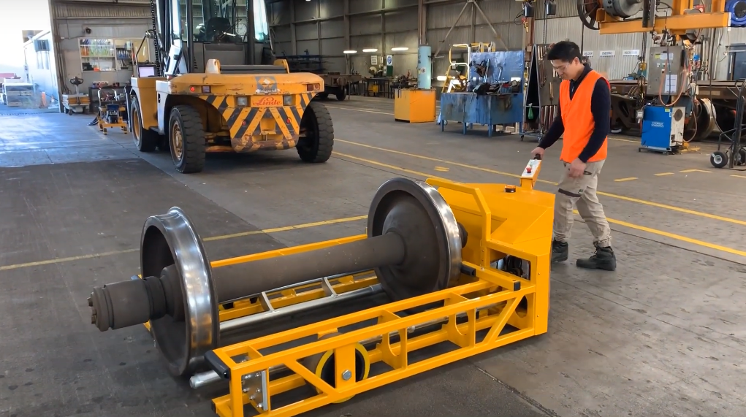
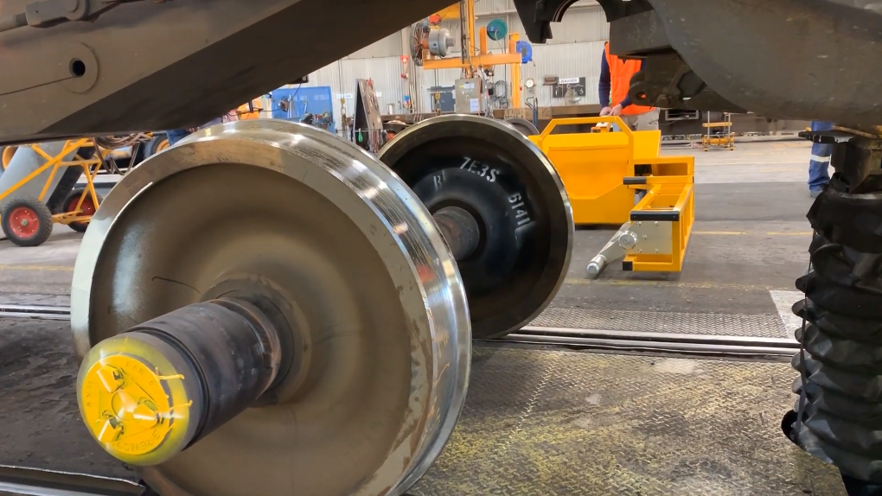
Intelligent, simple & collaborative solutions
Electrodrive’s Wheelset Mover is a custom-engineered, battery-powered device capable of moving large cylindrical objects such as train bogies, spools and drums to enable a single operator to move safely and swiftly with minimal effort—saving time, increasing productivity and reducing the risk of injury.

Slide 3
The problem
Traditional methods for moving rolling stock equipment are risky
and time consuming, requiring large forklifts and multiple people

Slide 4
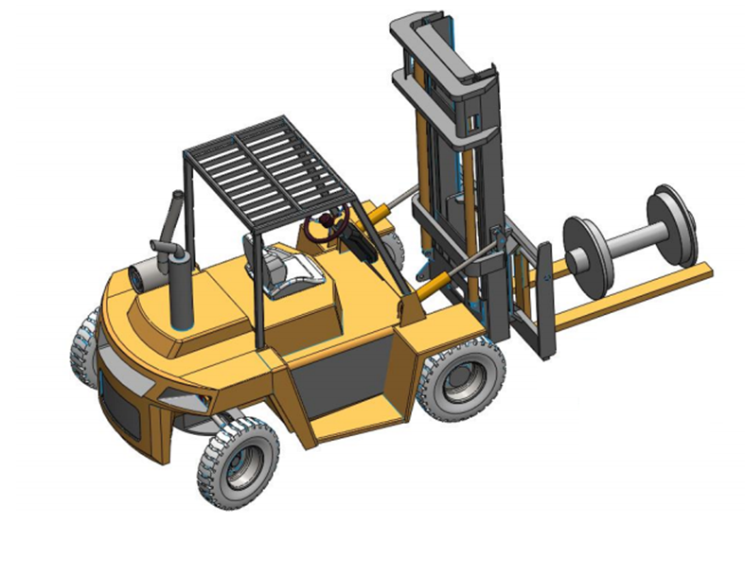
The problem
Traditional methods for moving industrial rail equipment (such as bogies and wheelsets) are risky and time consuming, requiring large forklifts and a minimum of 2 “spotters” at ground level (one either side of the train carriage) additional to a forklift operator to complete the task.
The safe operating space required is disproportionate to the task being done. There is also a reliance on the availability of the 10T forklift and licenced driver.
(pictured) a forklift is a large piece of equipment with the operator sitting over 2m higher than the staff on the floor. There are blind spots and the overall length of the operation is 6.7m which involves the forklift to move forwards, backwards and swivel around 90 degrees in a relatively small space.

Slide 5
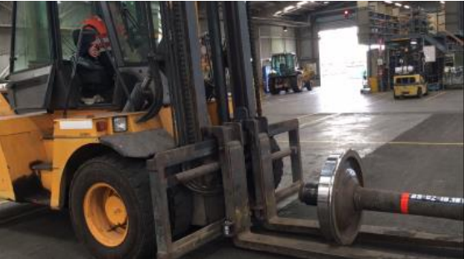
Current process
Three staff members required: two “spotters” either side of train carriage and one forklift operator
Whilst two staff are removing the wheel plates from the bogies, the 10T forklift operator positions the machine in line with the bogie.
The wagon is lifted from a central floor mounted hoist. Once at a sufficient height, the two staff roll the wheels sideways around 500 mm to clear the axle boxes.
Under direction from the Dogman, the forklift is driven in and the tines are closed to lift the wheels off the track. Forklift is then reversed and swung around 90 degrees to place wheel set on ground. This is repeated for the second wheel set.
The process is then run in reverse, with new wheels being placed on the track under the wagon, with the staff moving them in place and lowering the wagon to allow wheel plates to be re-attached.

Slide 6
The solution
THE ELECTRODRIVE WHEEL SET MOVER

Slide 7
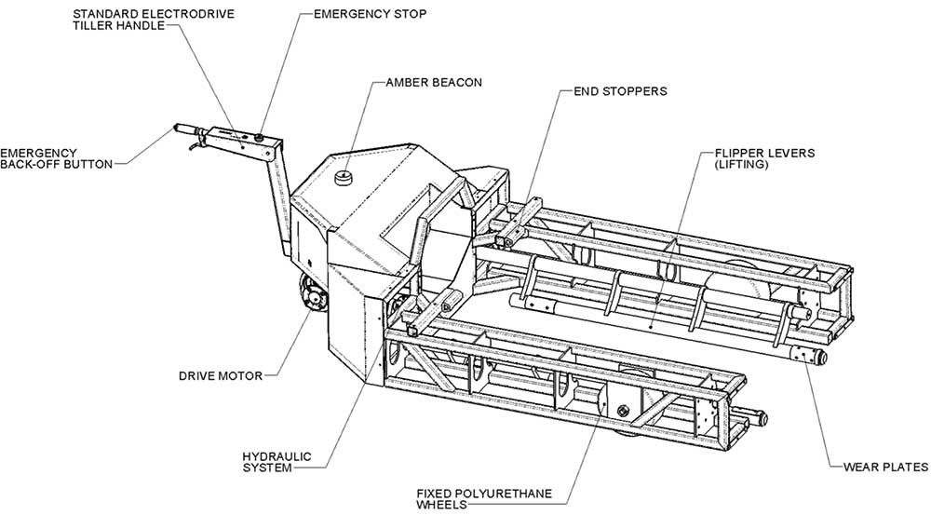

Slide 8
FEATURES & specifications
Load capacity | Move up to 1400 kg on flat surface.
Max. speed | Up to 4.1 km per hour (programmable)
Speed mode | Three speed control with forward, reverse and emergency stop buttons.
Usability | No license required. Quiet, smooth operation. Zero emissions. Battery operated and rechargeable. Key on/off switch. Ergonomic design with folding tiller handle. Hydraulic park brake release—to enable manual operation in the event of a flat battery.
Country of origin | Designed and manufactured in Australia.
Safety features | Emergency stop button. Emergency back-off button. Hydraulic manual override.
Warranty | Comprehensive 12-month warranty. Six month warranty on battery and charger.
Service | Training and servicing programs are available.
Battery | Two 12V 73Ah MK-cyclic gel / suspended electrolyte batteries (deep cycle, long-lasting, maintenance-free) with 24V smart charger.
Dimensions (L/W/H) | 3264/1505/869 mm 2704/1505/869 mm (will tiller arm raised)

Slide 9
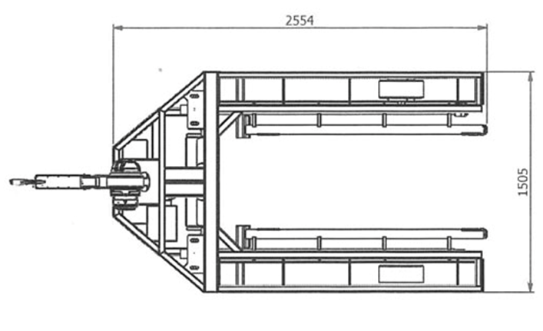
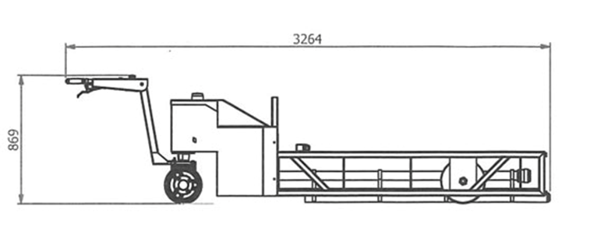

the driving handle (tiller arm) can be lifted vertically during operation to reduce the overall length of the machine to 2704 mm and reduce the turning circle.

Slide 10
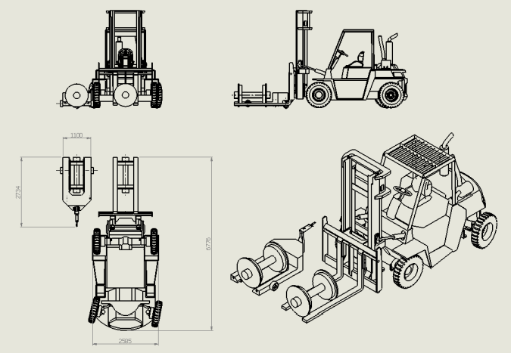
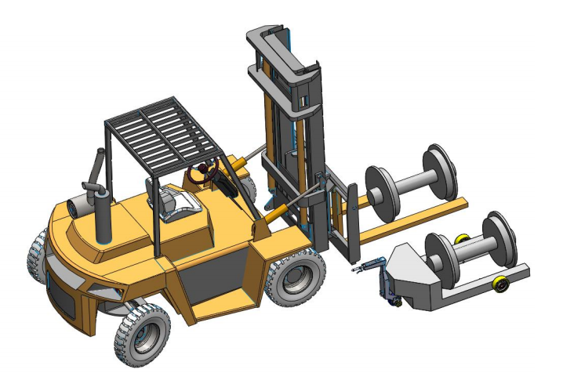
THE BENEFITS
Overall length has been reduced from 6.7m to 2.7m (60% reduction)
Overall height of operator changes from approx. 2.7m to standing height
Operator has full visuals of all points and staff members in the vicinity (no blind spots)
Task is now a two man operation reducing process labour costs by 33%
Operator does not require a forklift licence
Reduced usage of 10T (40hrs/mo) reduces wear and maintenance costs
Wheel Set Mover has zero emissions (removing diesel fumes from enclosed space)
Wheel Set Mover can be used for all wheel moves around workshop removing the need for forklifts driving in workshop delivering wheels (potential risk)
Pictured: Linde H100 10T Forklift versus the Wheelset Mover

Slide 11
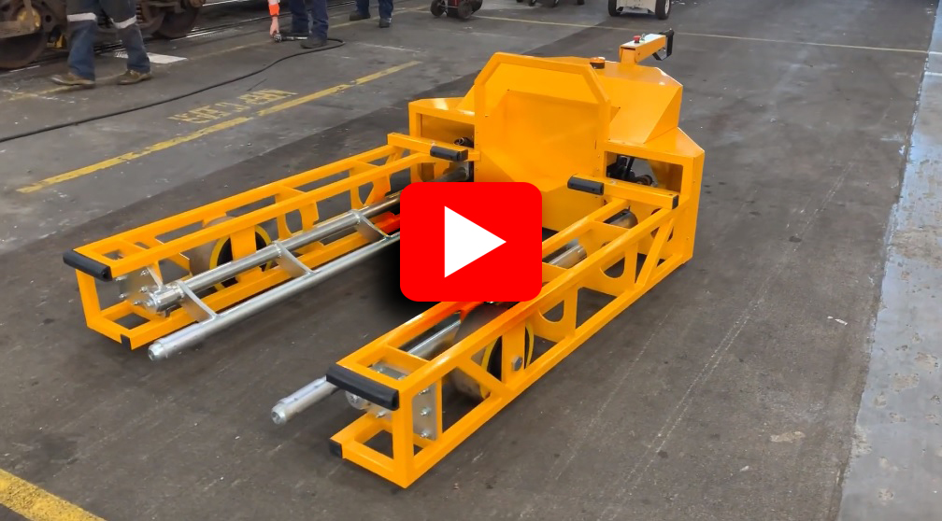

Slide 12
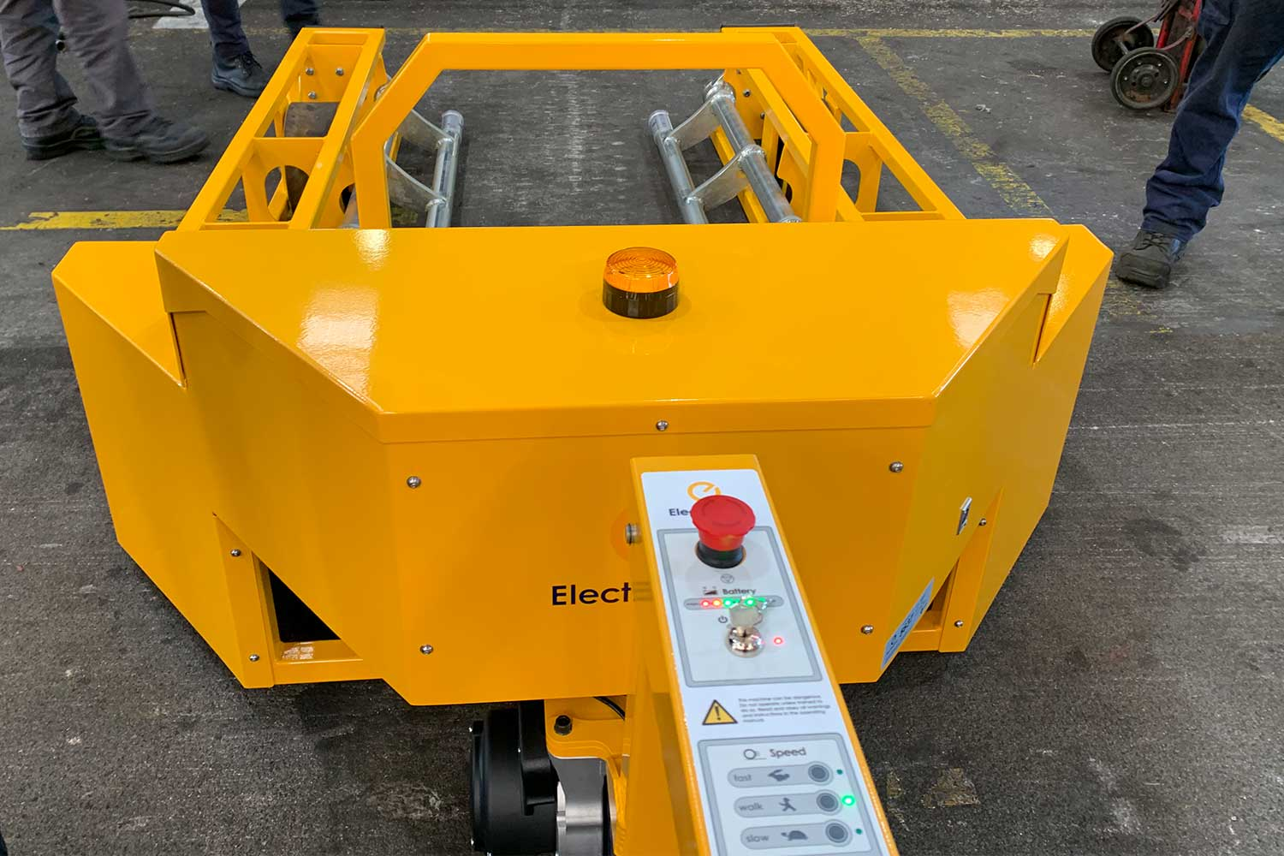

Slide 13
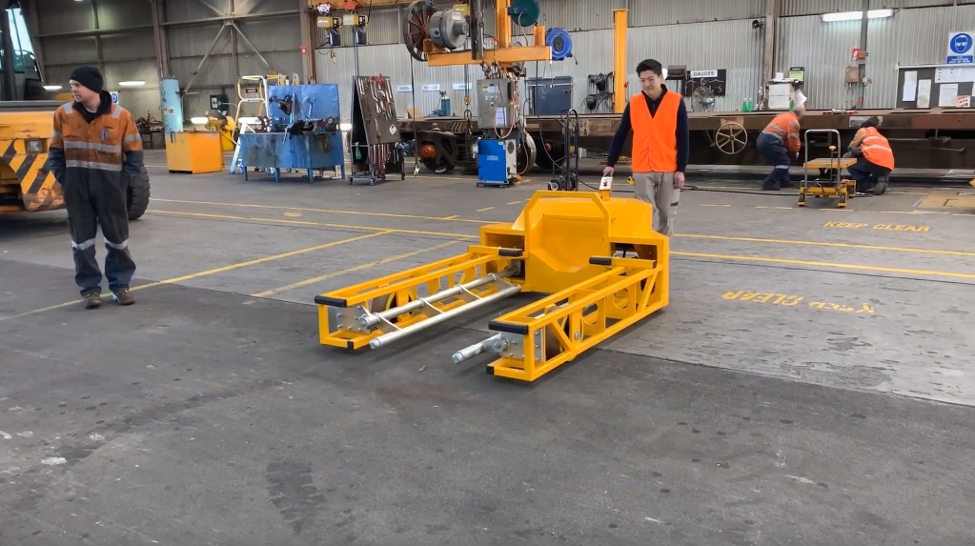

Slide 15
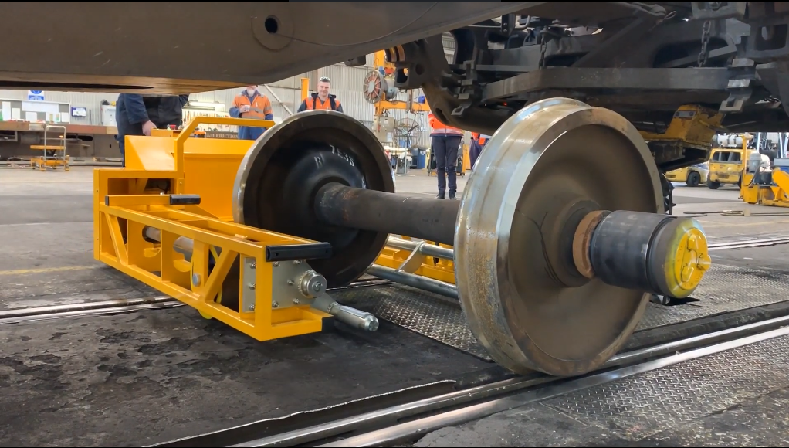

Slide 16
